Slide 1

SCiP, 2023
Business Meeting

Slide 2
SCiP Organizers / Openings
Thanks to all the amazing efforts of SCiP President Caitlin Mills.
Election for 2023 leadership positions is ongoing! Please go vote.

Slide 3
Conference Report
We had 10 posters and 36 presentations (1 symposia) scheduled!
3 Castellan full paper submissions.
8 Birnbaum awardees this year. Warm thanks to generosity of Birnbaum Foundation.
Welcome new student SCiP members!

Slide 4
SCiP Budget / Membership
SCiP budget is healthy (about $6,000, approximately 1.5 conference “buffer”)
Registration based on cost of conference to cut as even as possible.
Immense thanks to Psychonomic Society for their support (approximately $5000).

Slide 5

Thanks to Sponsor PST!
Please visit their website for more information https://pstnet.com/.

Slide 6

FABBS (fabbs.org)
FYI: SCiP is a member society. Advocacy for behavioral and brain sciences in Washington. Visit fabbs.org.

Slide 7
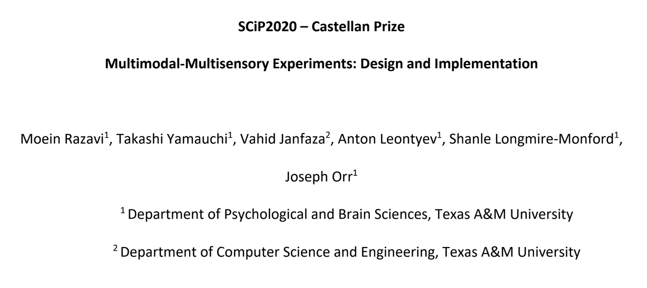
Congrats Castellan Winners!

Slide 8
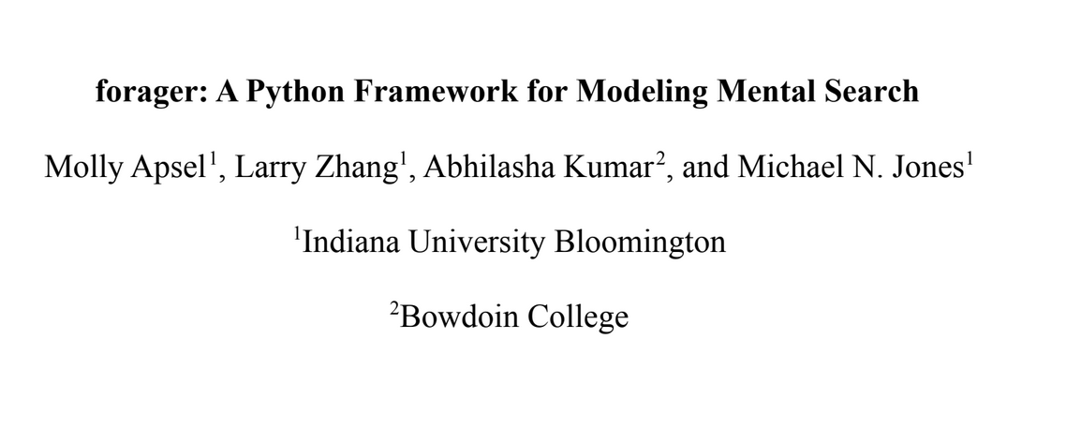
Congrats Castellan Winners!

Slide 9
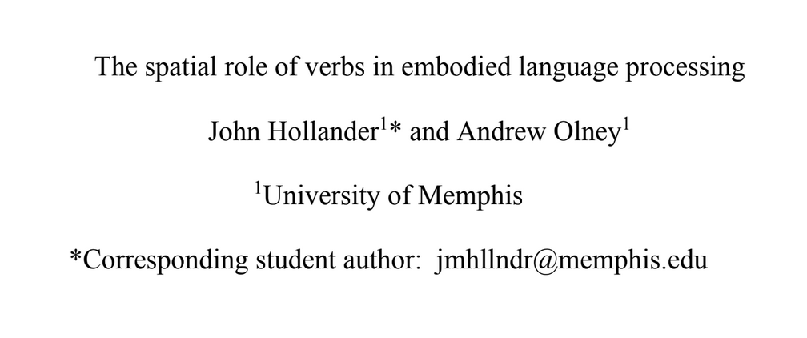
Congrats Castellan Winners!

Slide 10
SCiP 2024
SCiP 2024: New York!
All feedback is warmly welcomed.
Consider joining on as President or Steering Committee member for 2024! Nominate folks when submitting for next year.

